Slide 1
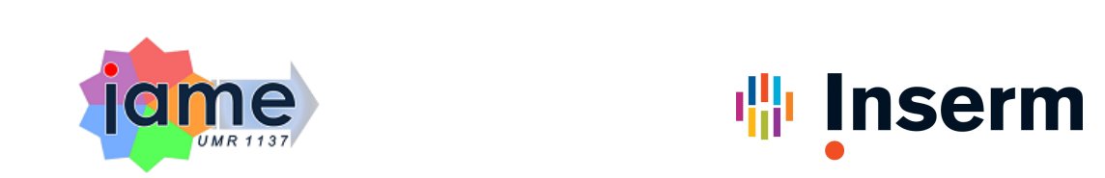
Modeling E. coli Colonization in Murine Models of Urinary Tract Infections
Carlos Olivares, Charles Burdet, Ariane Amoura, Imane El Meouche, Emmanuelle Comets

Slide 2
Introduction

Slide 3
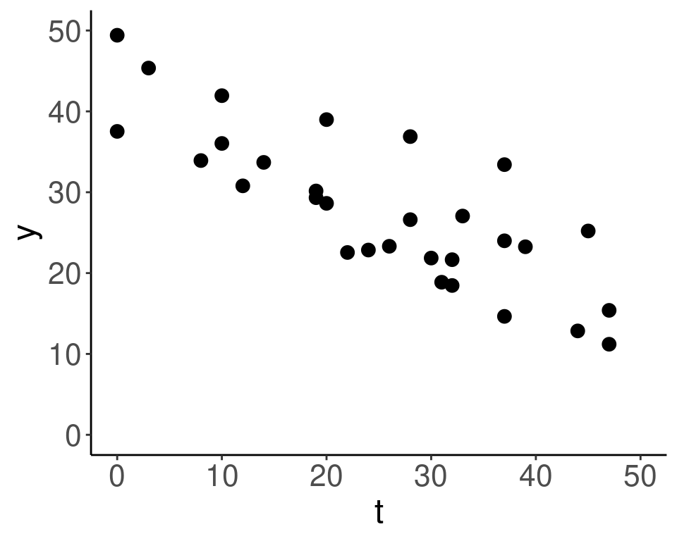
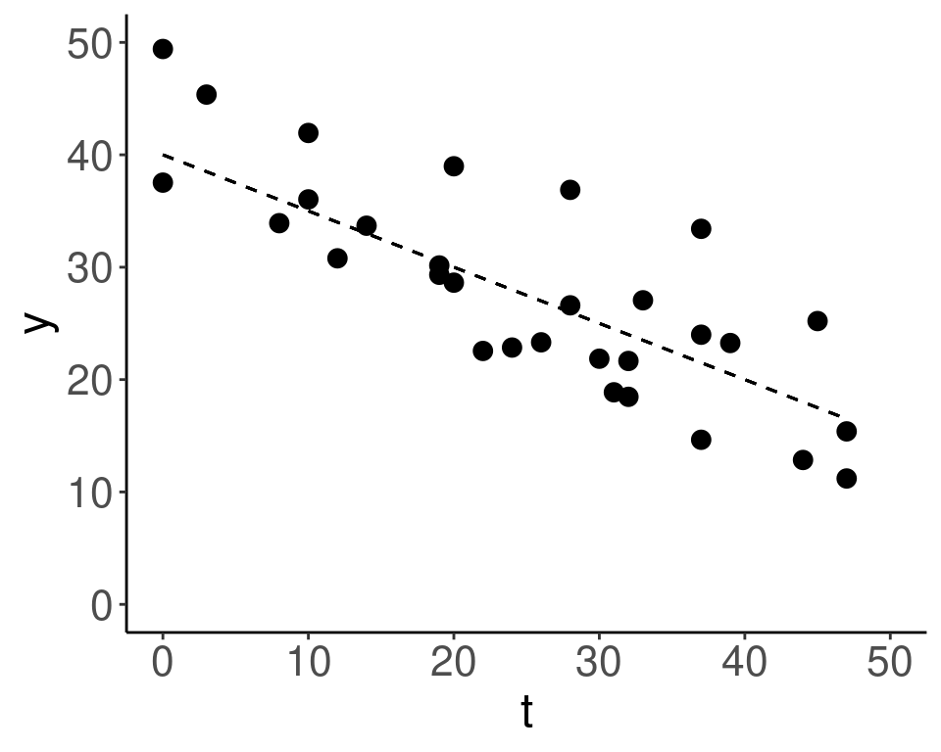
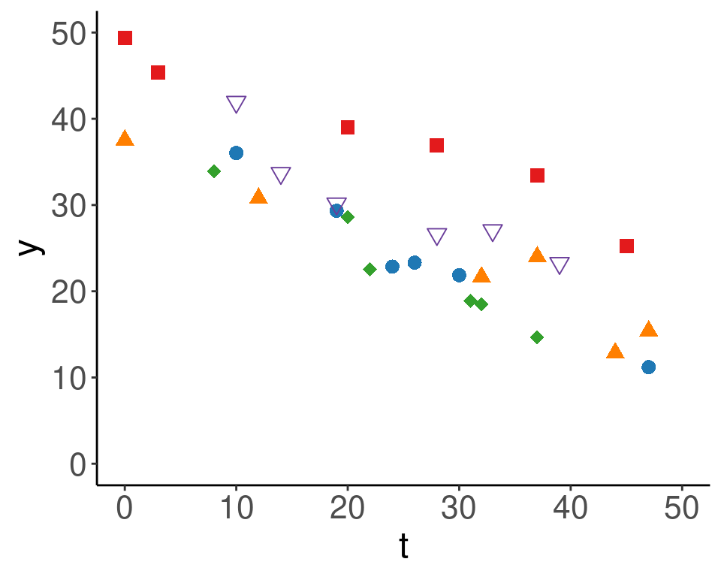
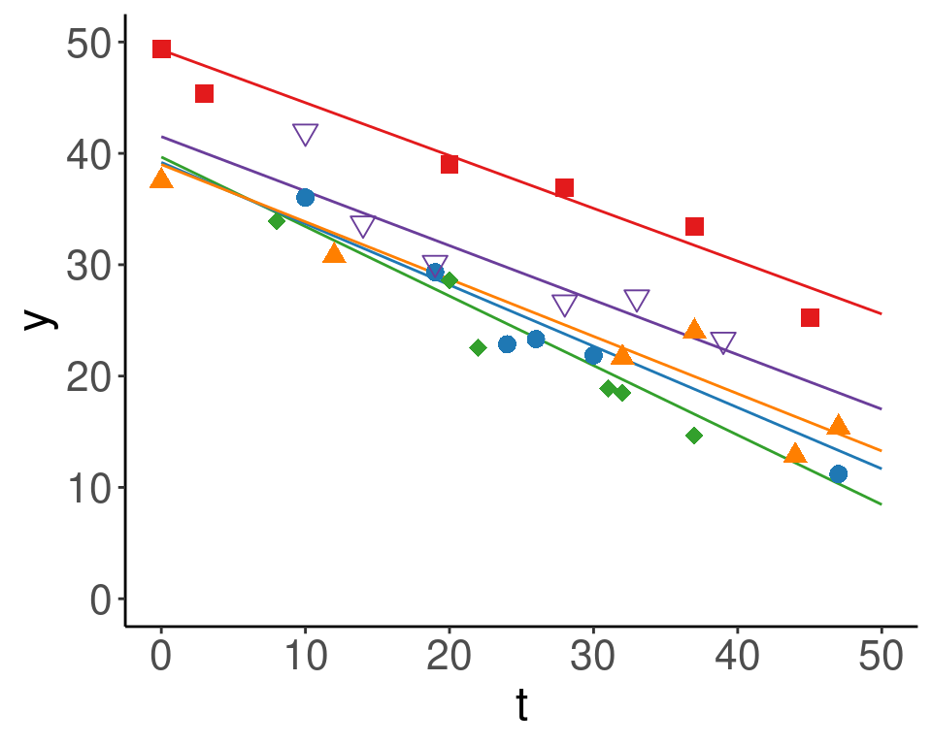
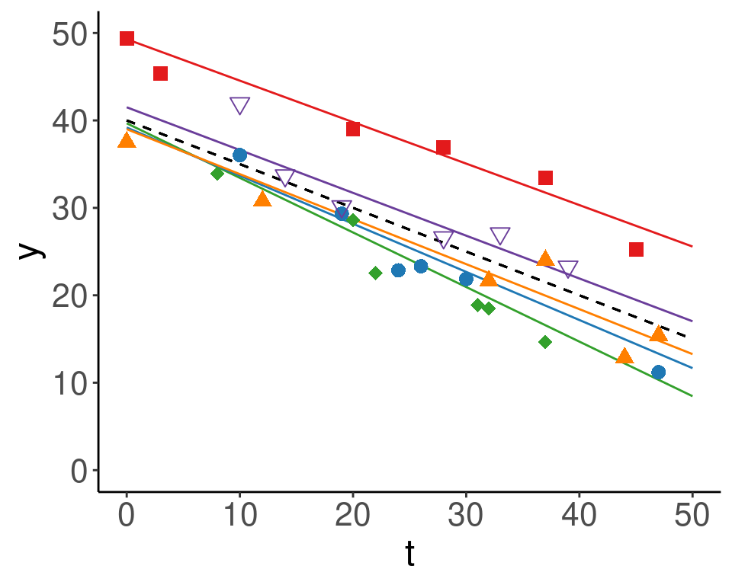
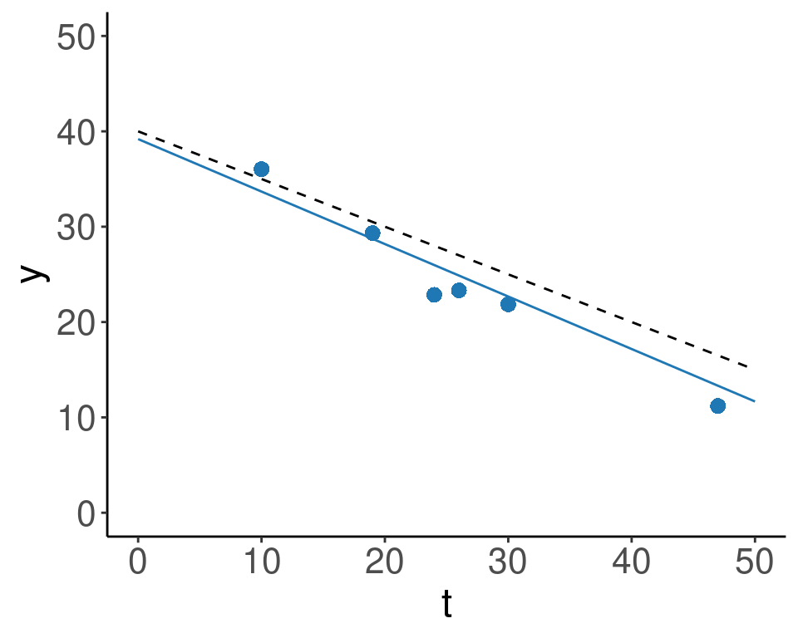
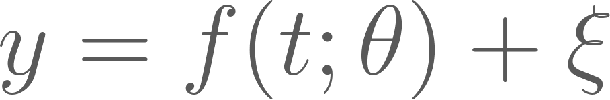
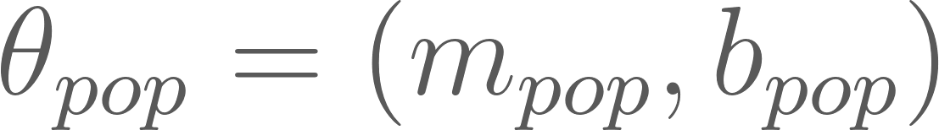
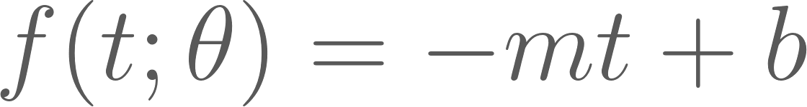
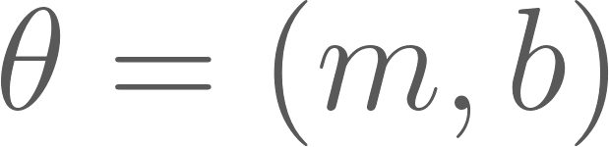
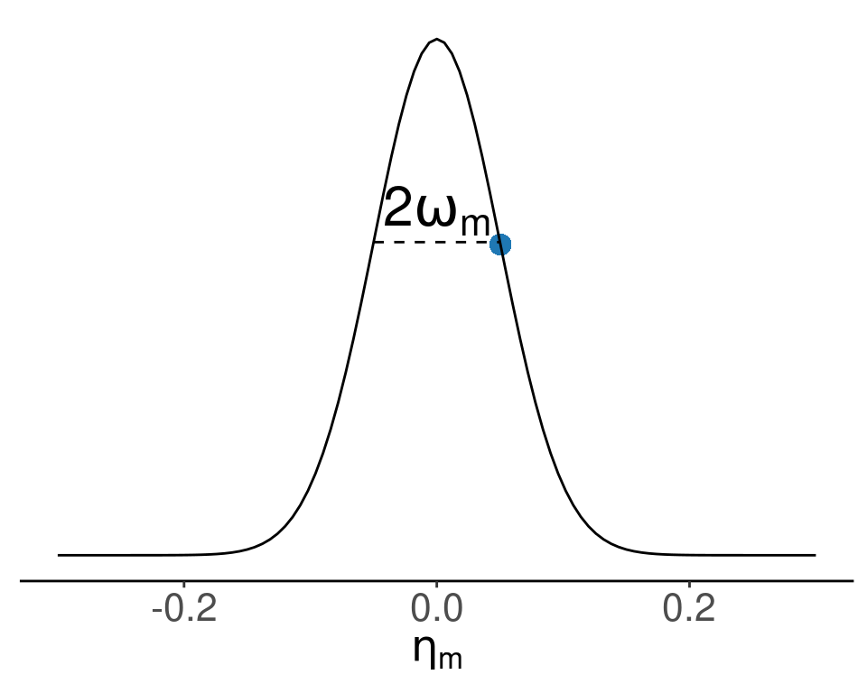
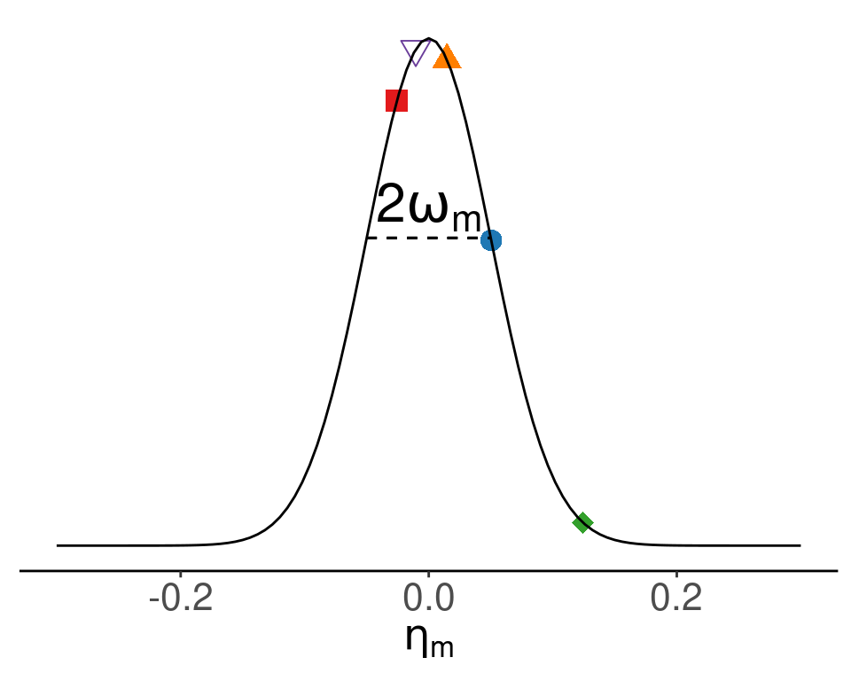
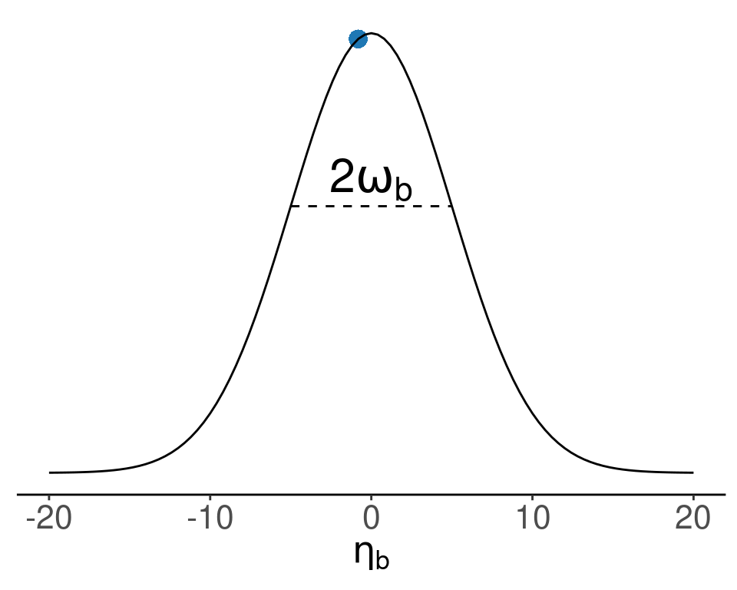
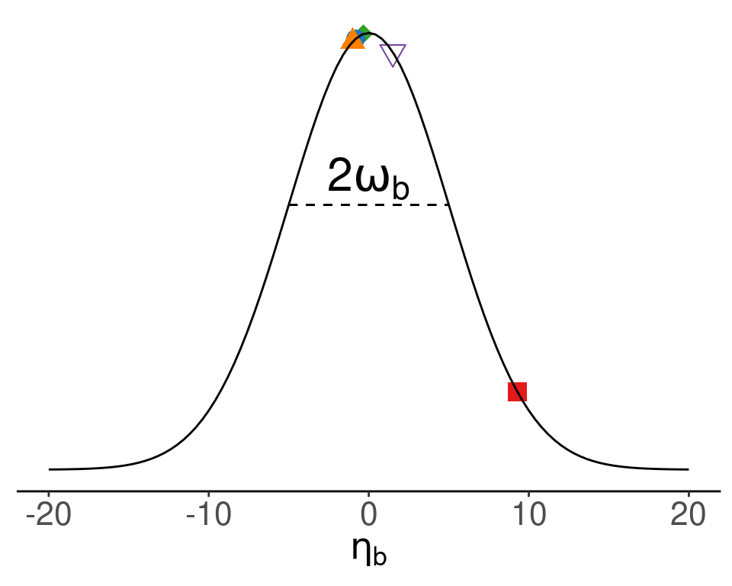



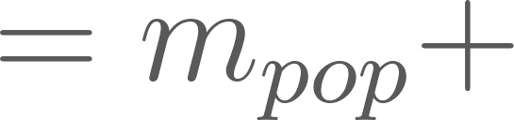

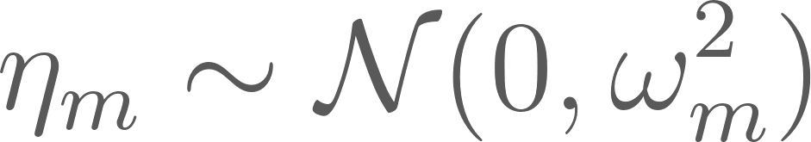

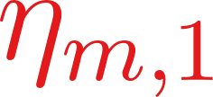


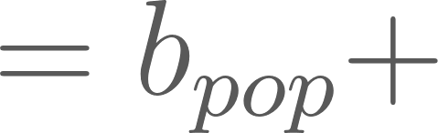

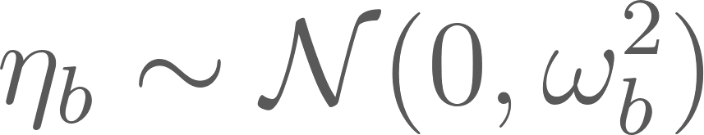


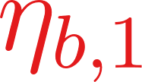


Mixed Effects Modeling
Structural Model
c(
"1" = "#e31a1c",
"2" = "#1f78b4",
"3" = "#33a02c",
"4" = "#ff7f00",
"5" = "#6a3d9a"
)
Mixed: Fixed and Random

Slide 4
Data Description

Slide 5
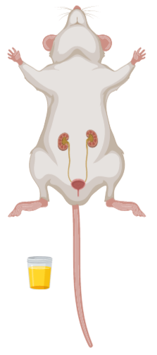
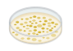
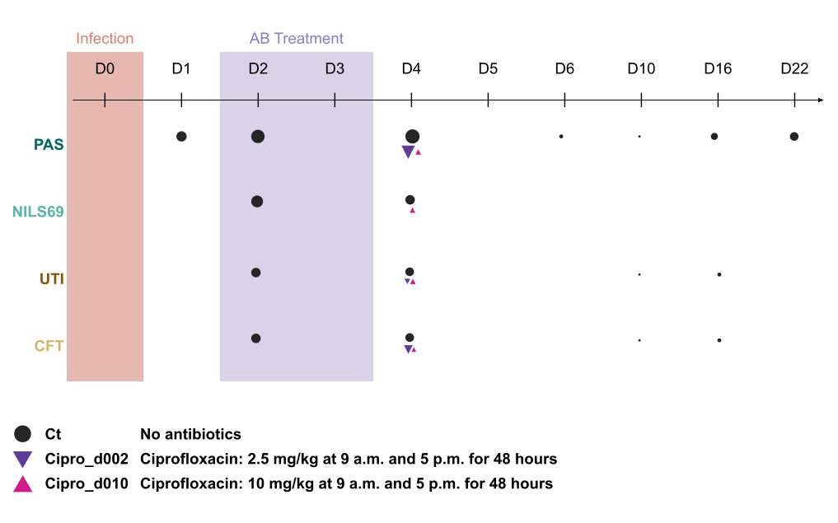
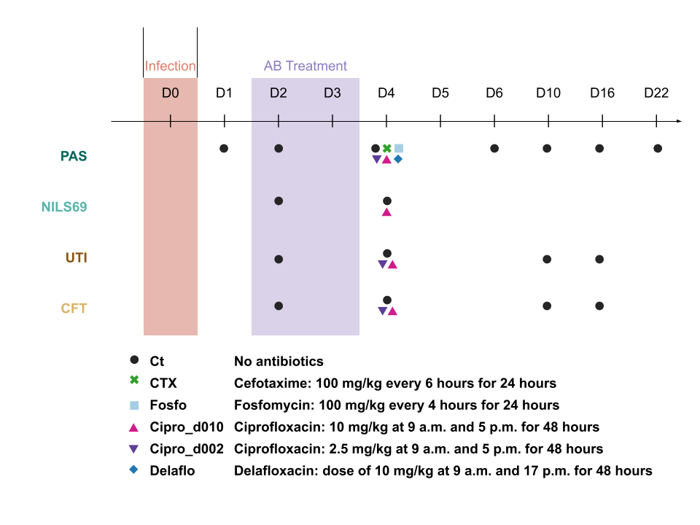
Sampling
Ascending pyelonephritis UTI mouse model
4 strains
3 antibiotics treatments
A. Amoura et al. Cell Host & Microbe, (2024)

Slide 6
Data handling
Data reported as
CFU/g in kidney (K) and bladder (B)
CFU/mL in urine
weight of organs in g
urine amount unknown
Data used in model
bladder, kidney: scale by organ size => total CFU per organ (amount)
Assumptions on mice
Urine volume (~1ml)
Total weight 20g ( for AB treatments)
Inoculum instantaneous adm and 10^8 CFU

Slide 7
Modeling PAS strain without AB

Slide 8


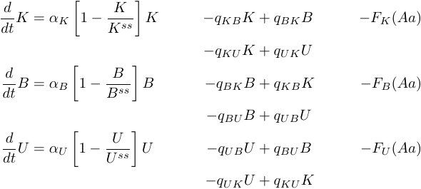

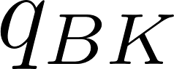

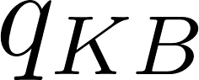
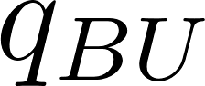
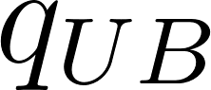
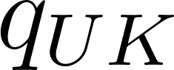
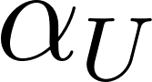

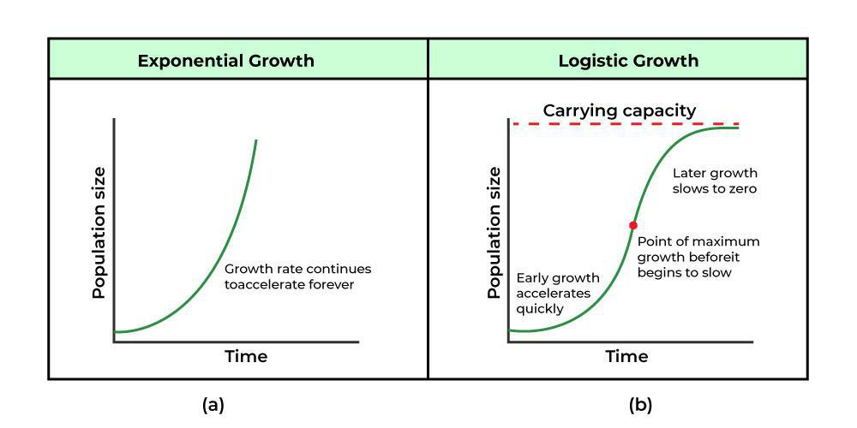
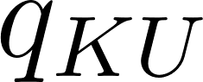
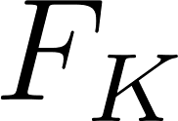

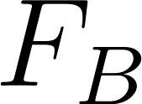
General Model
In
Kidney
Bladder
Urine

Slide 9
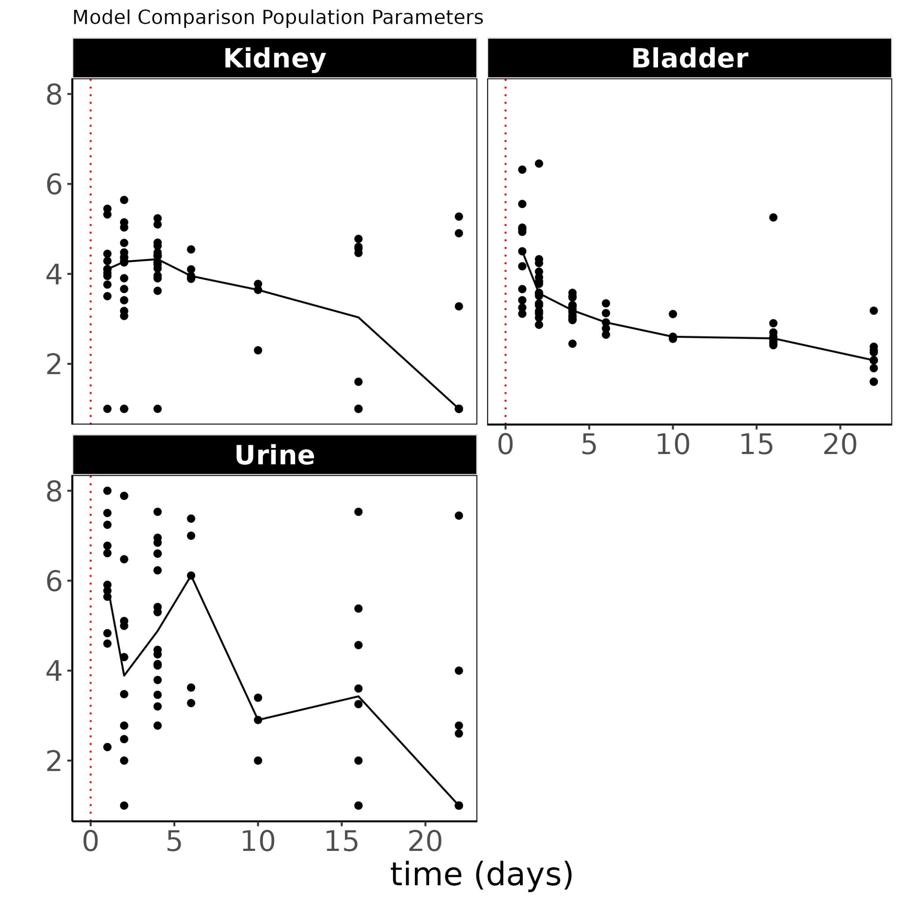
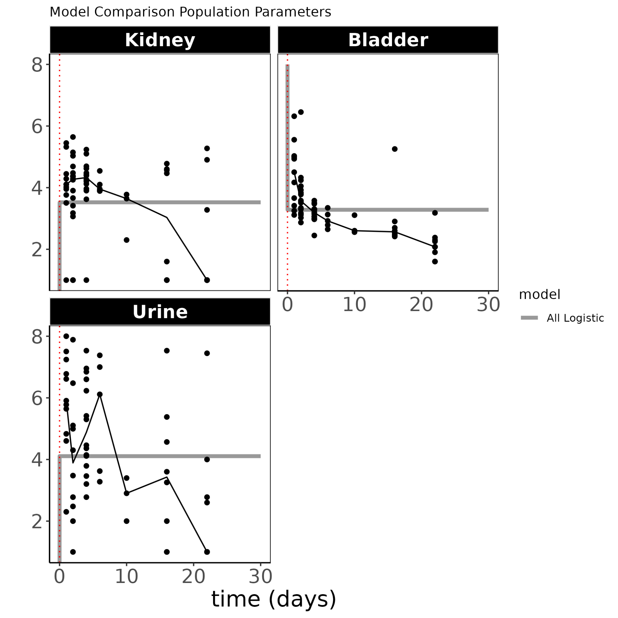
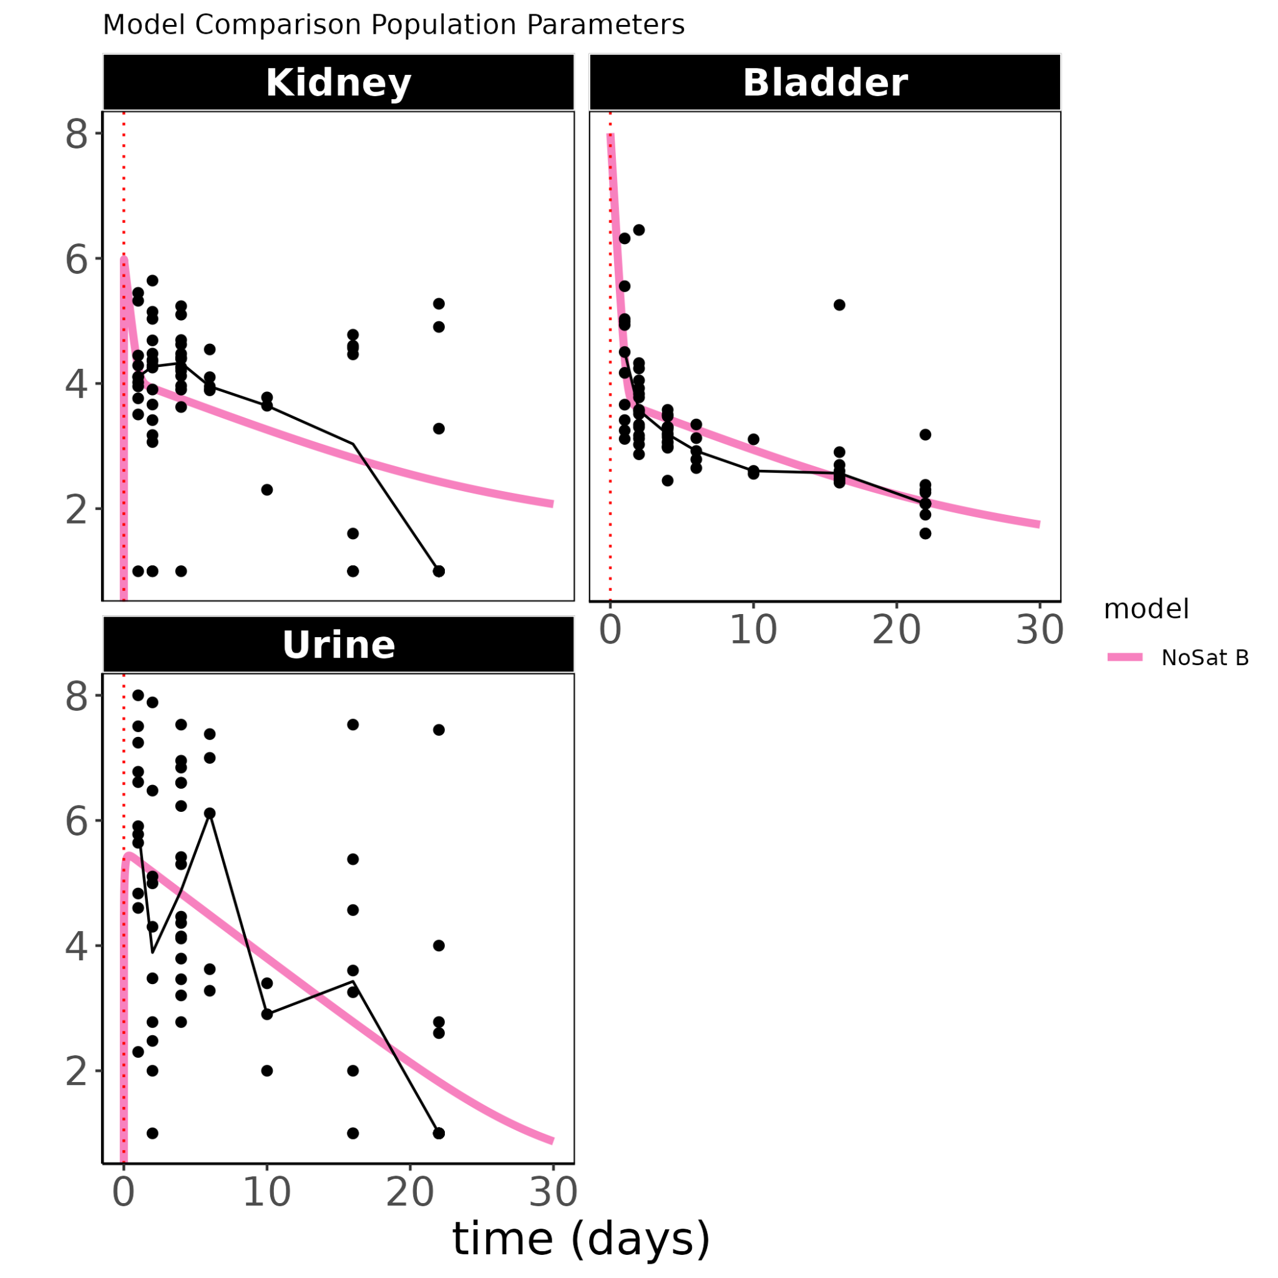
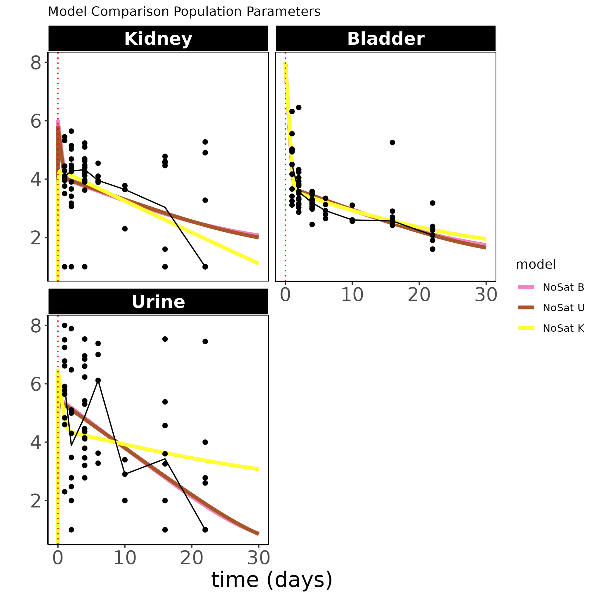
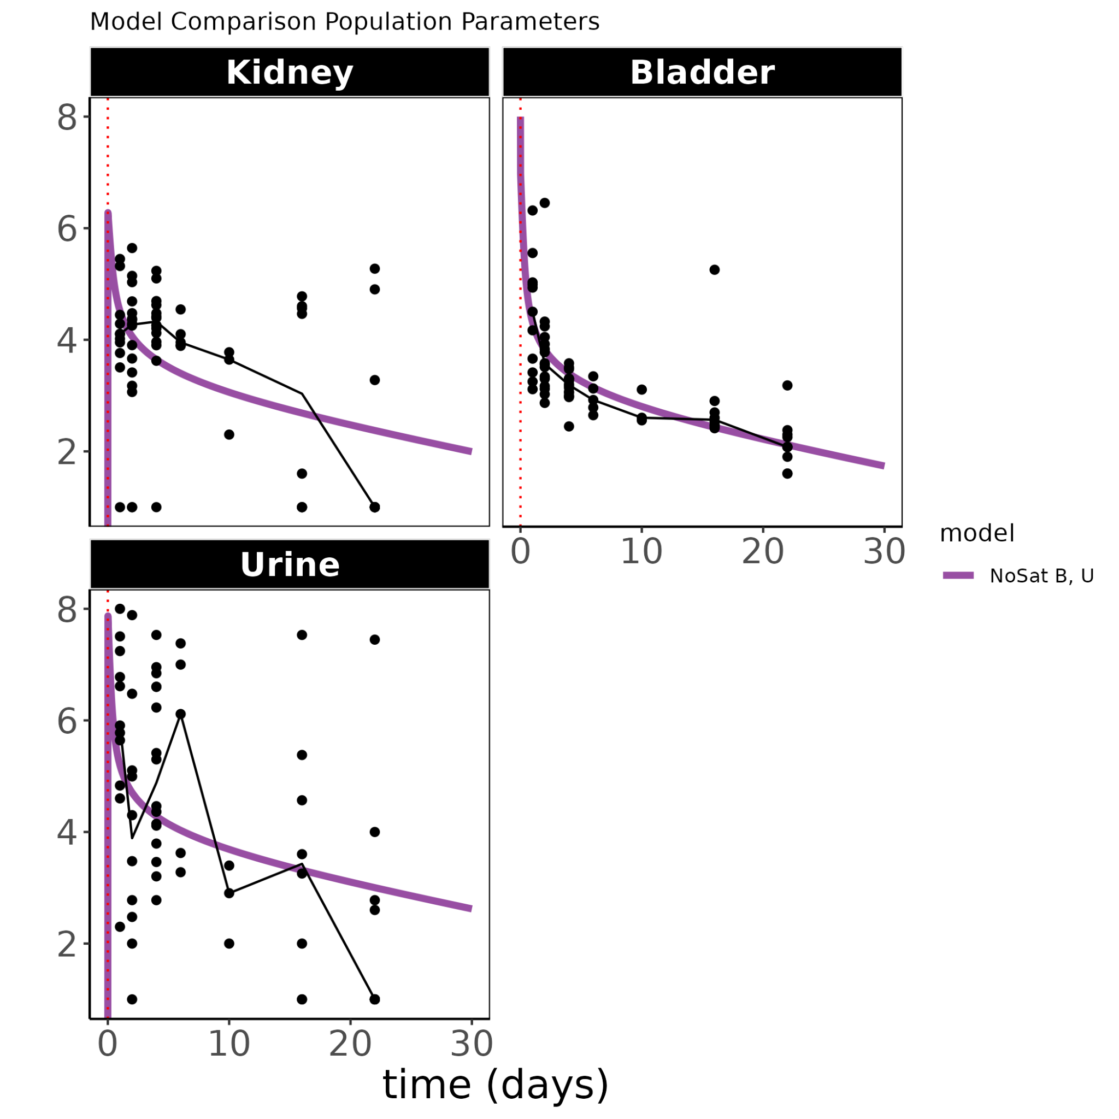
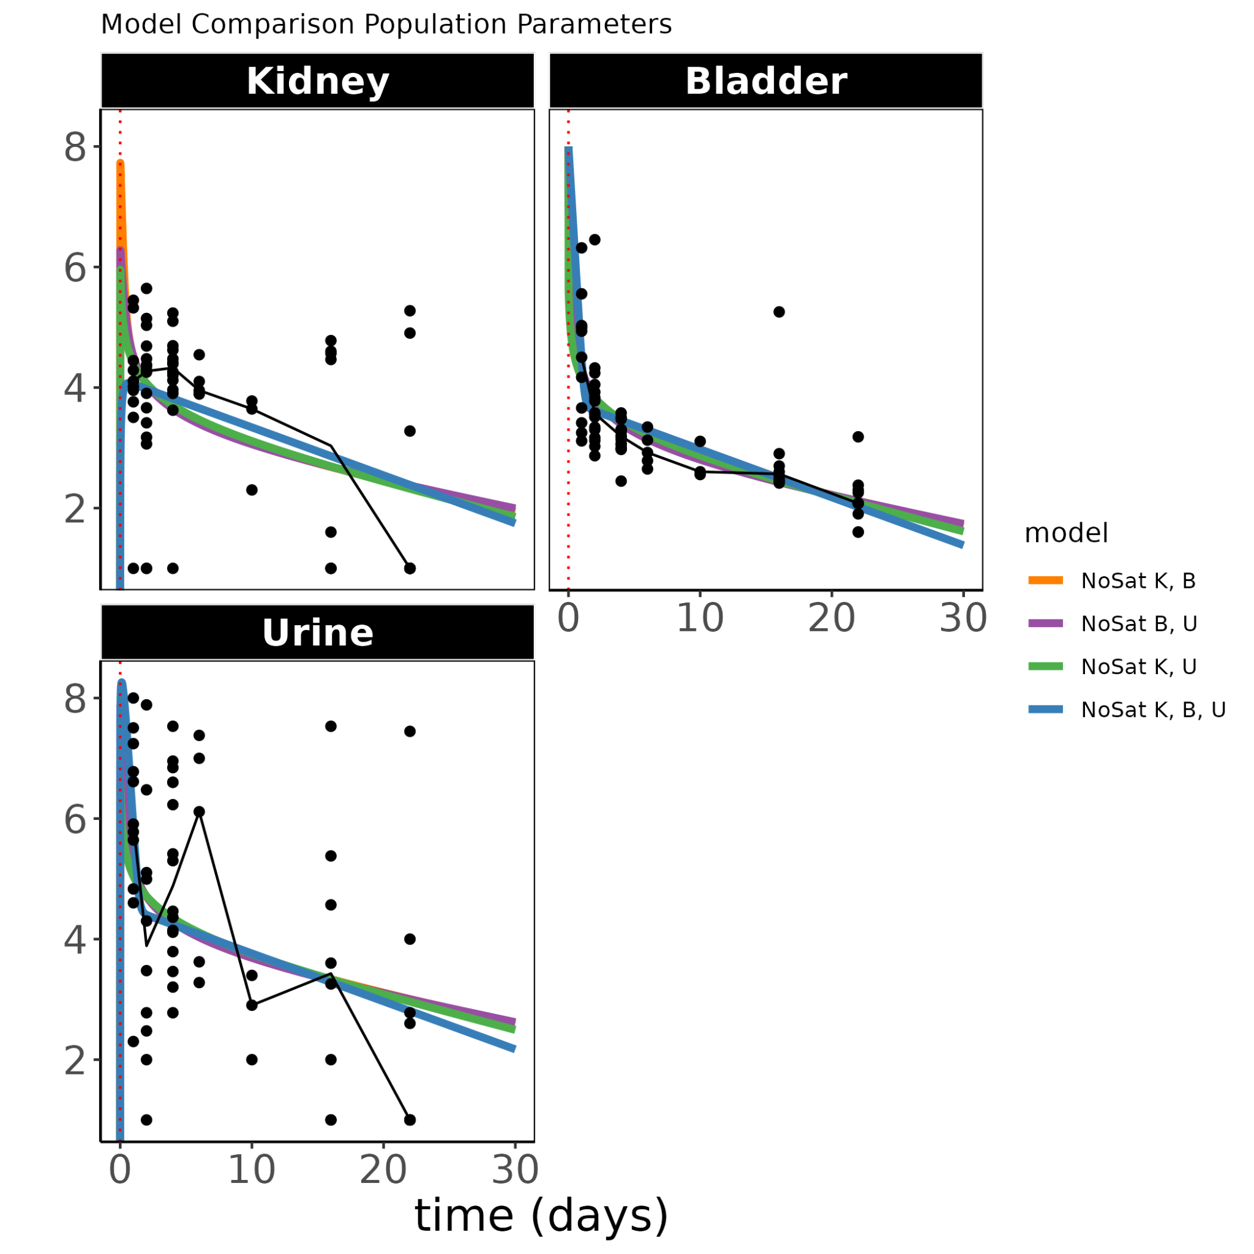
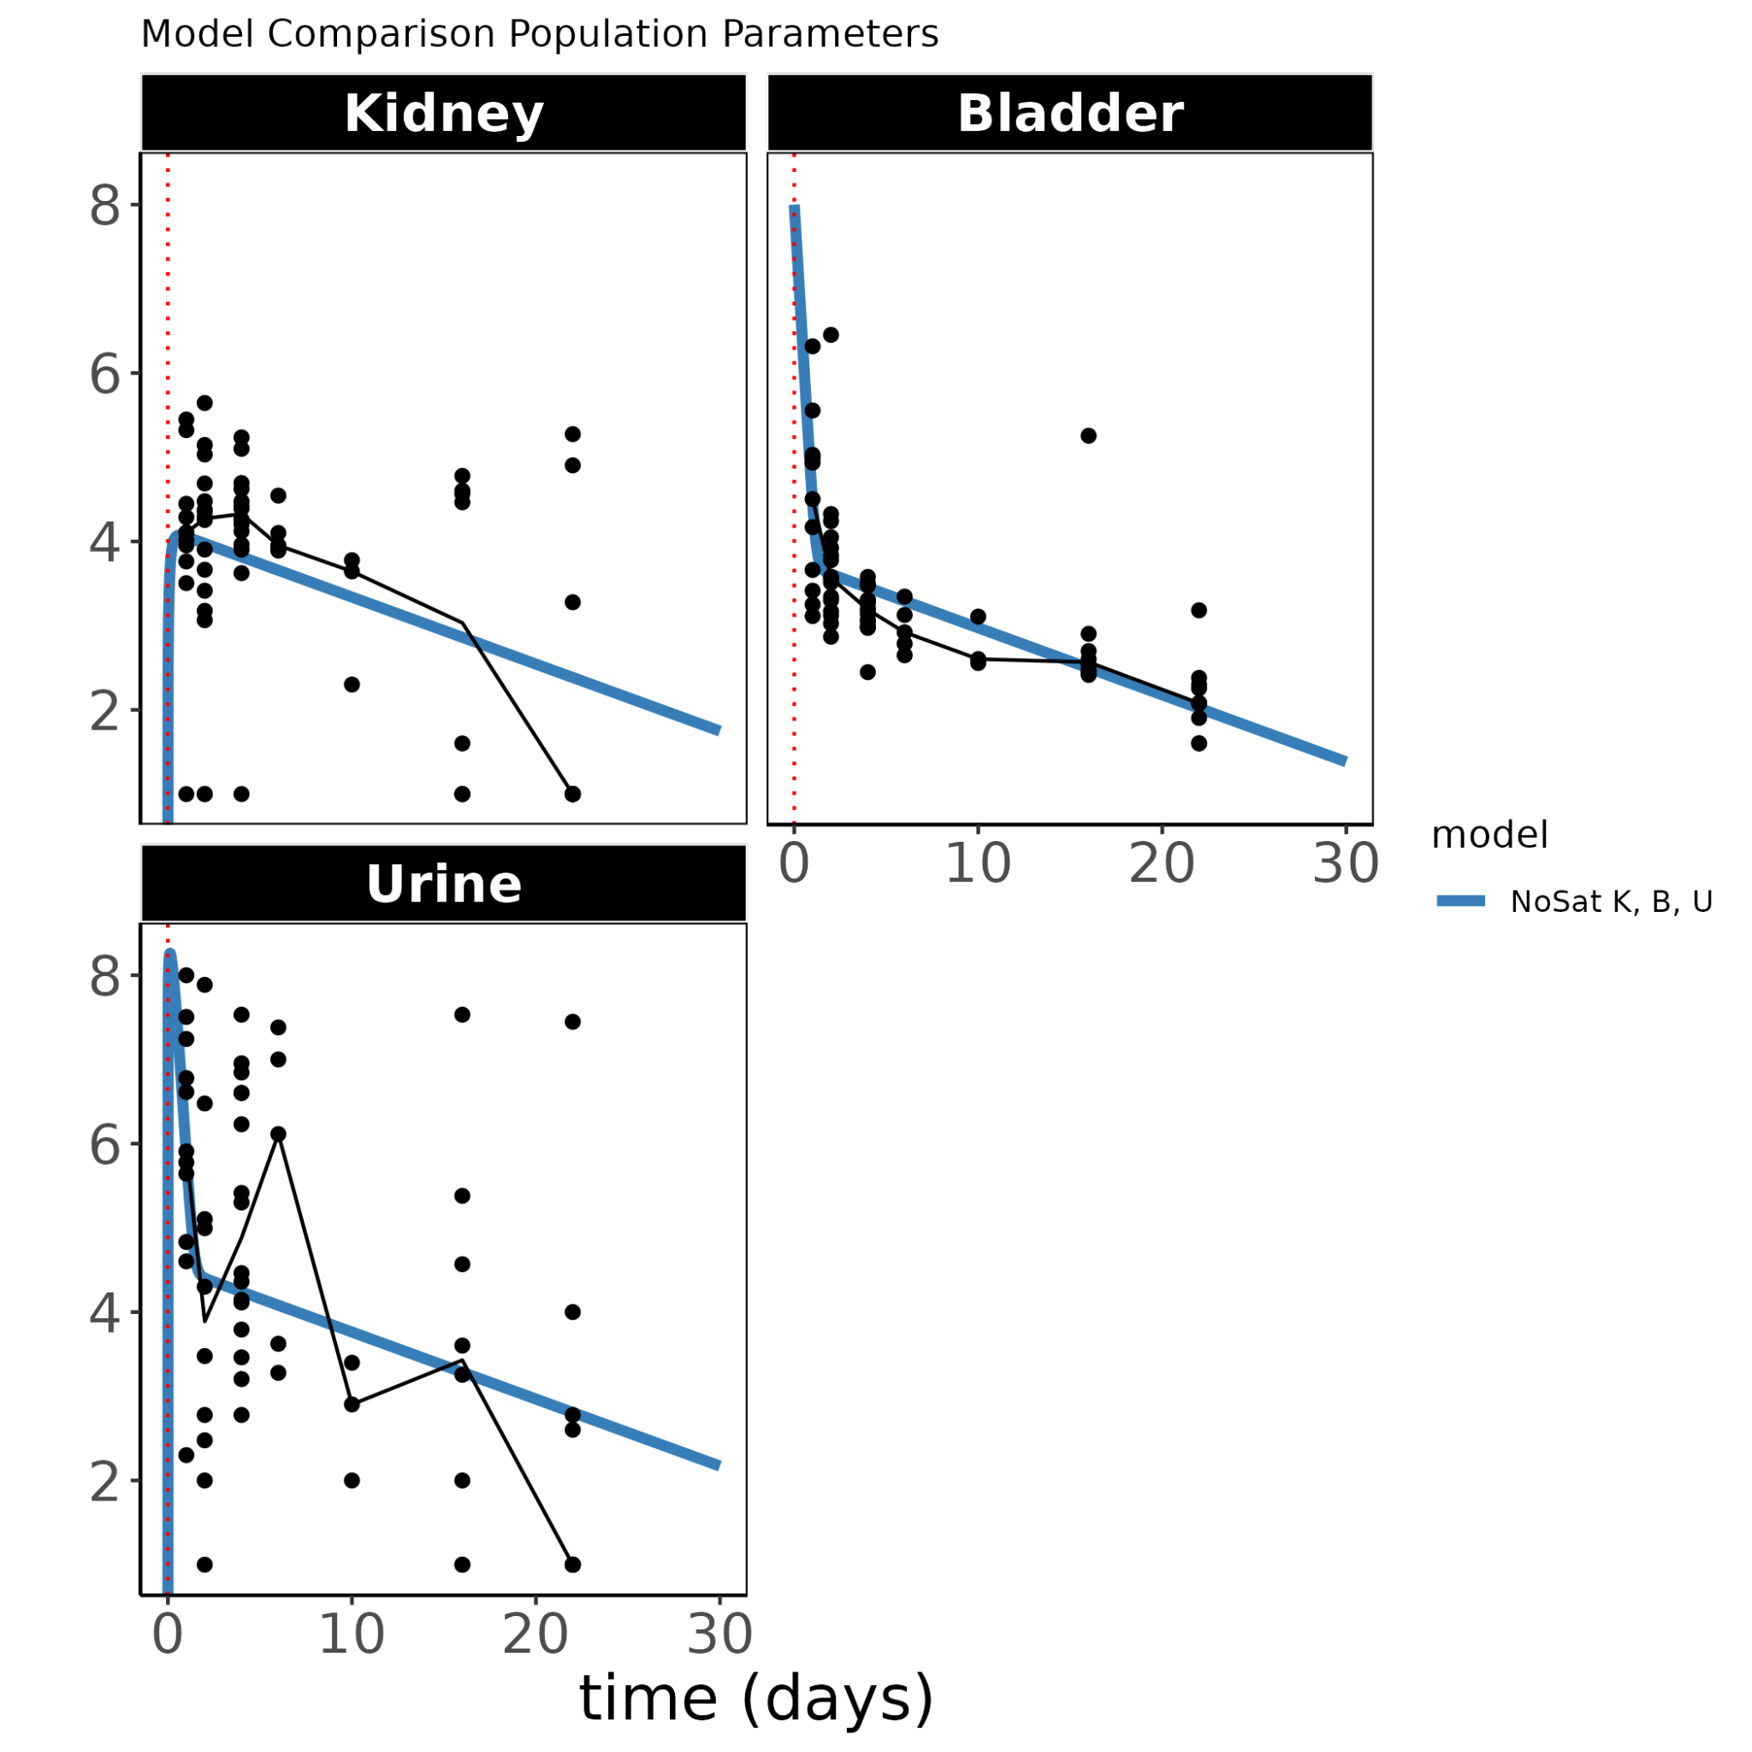
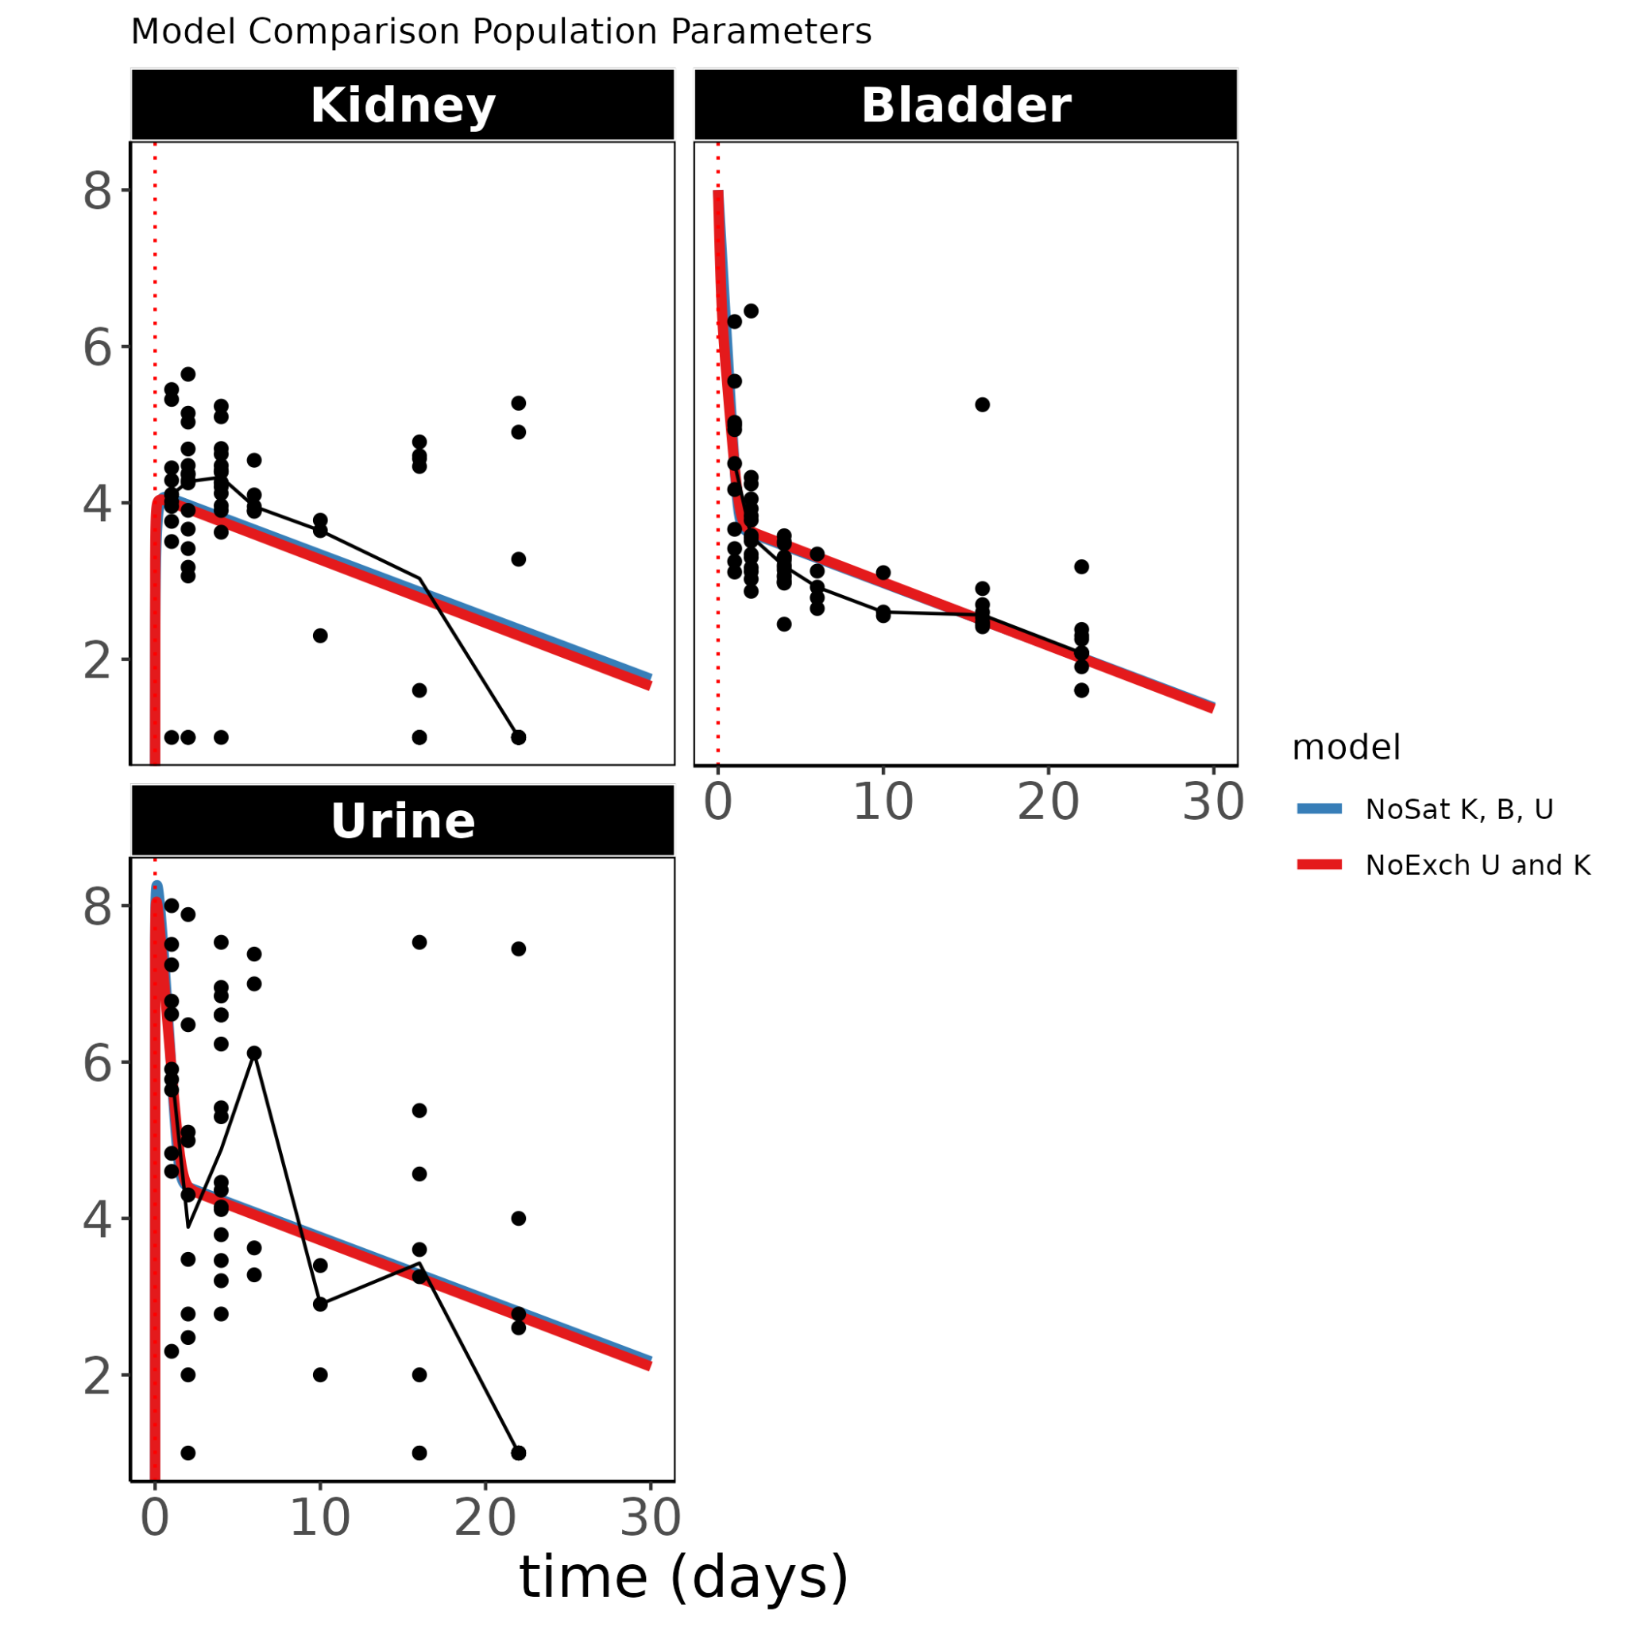
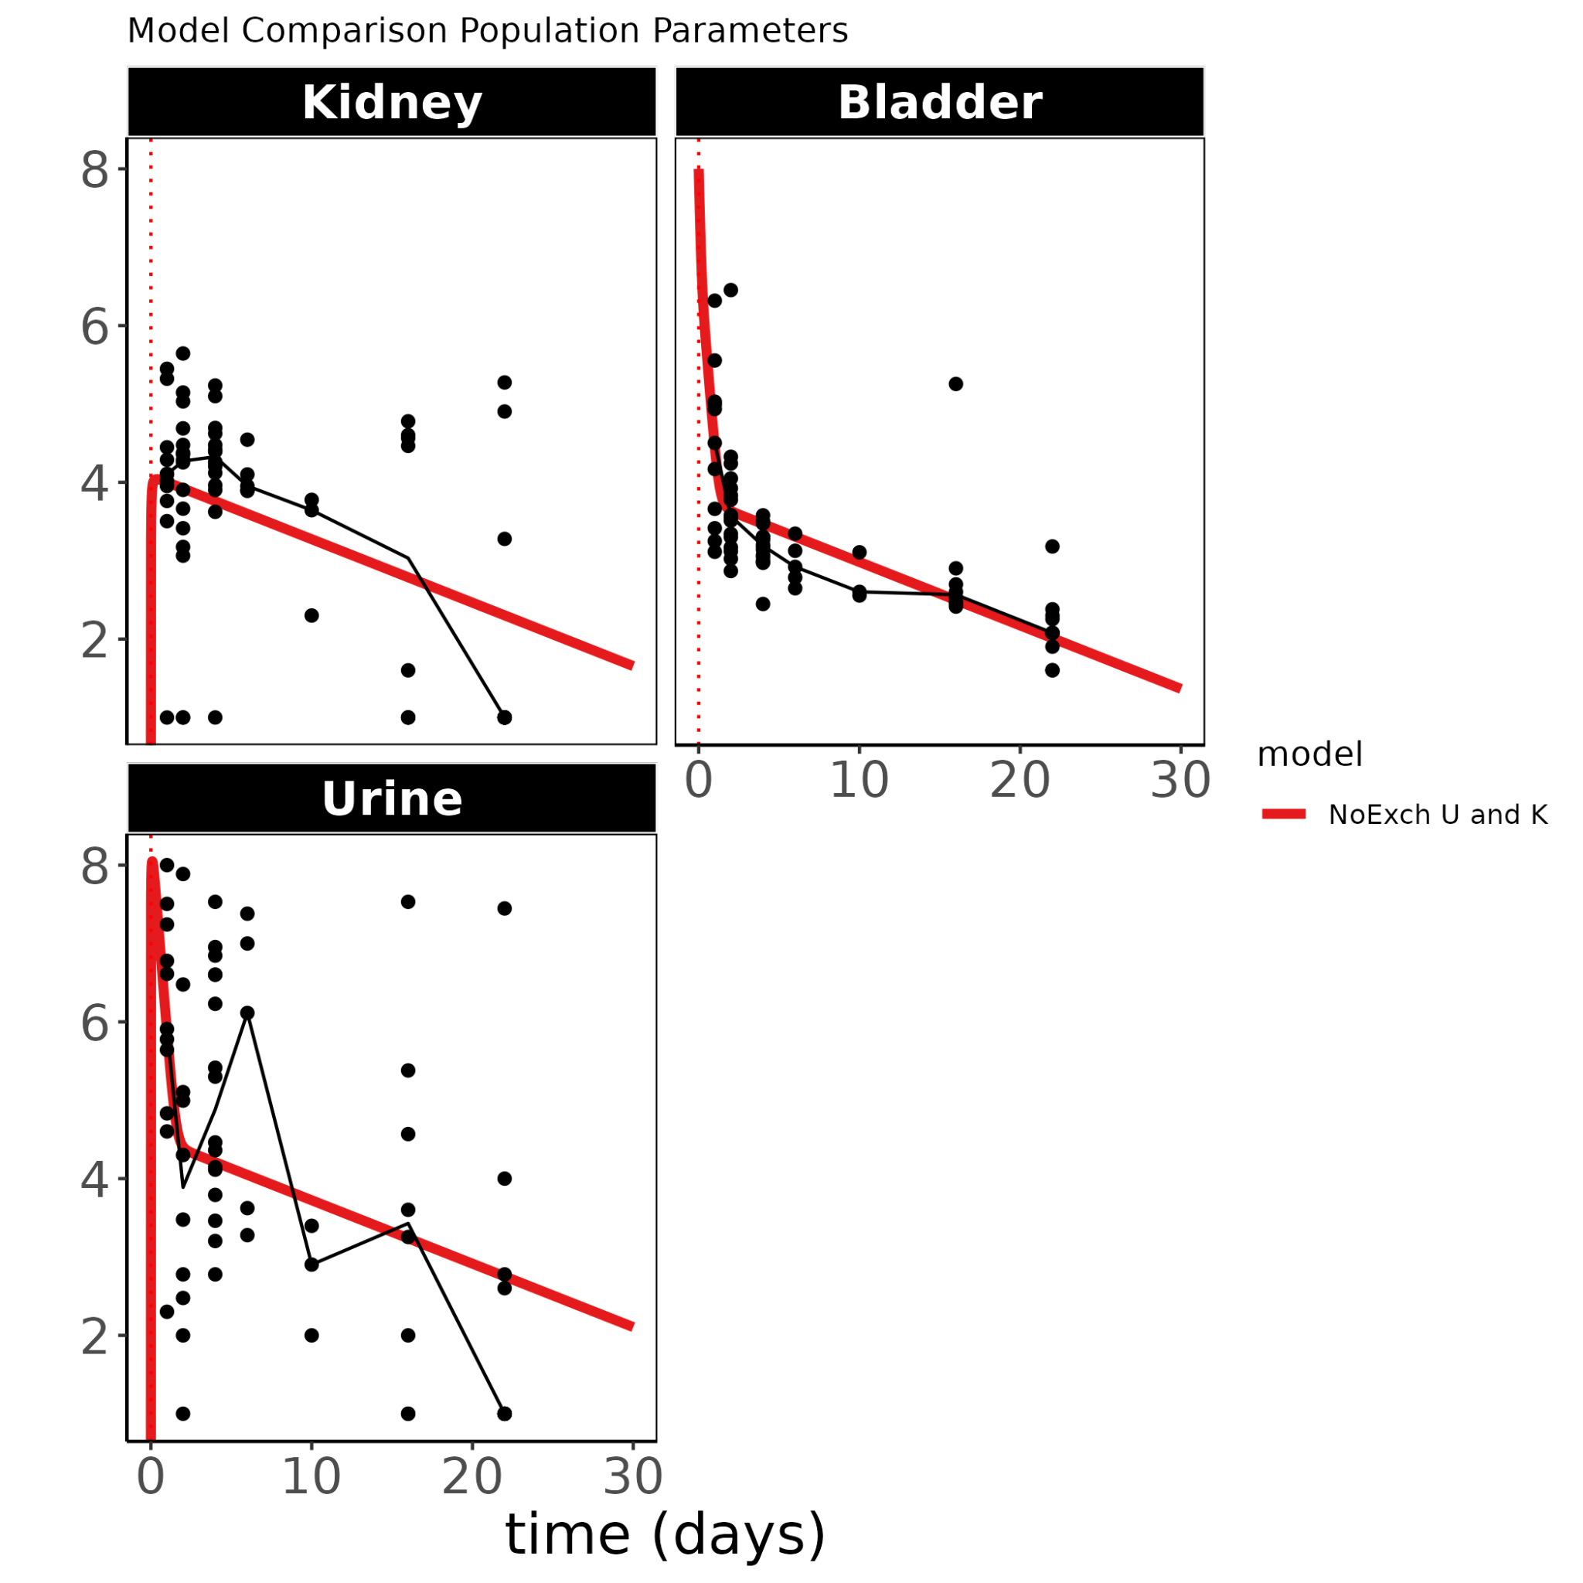
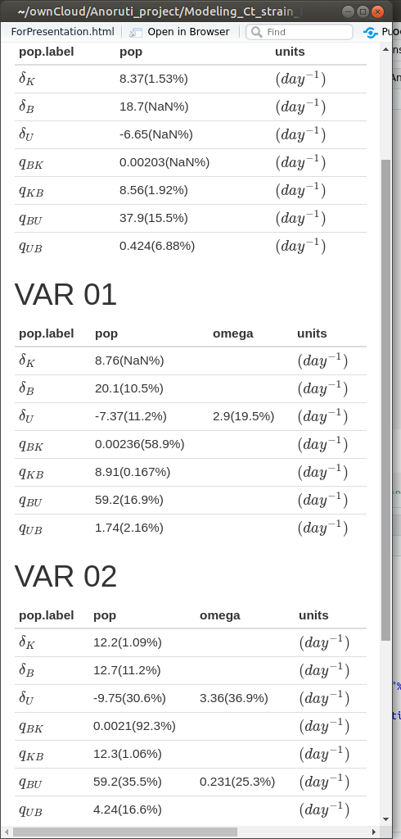
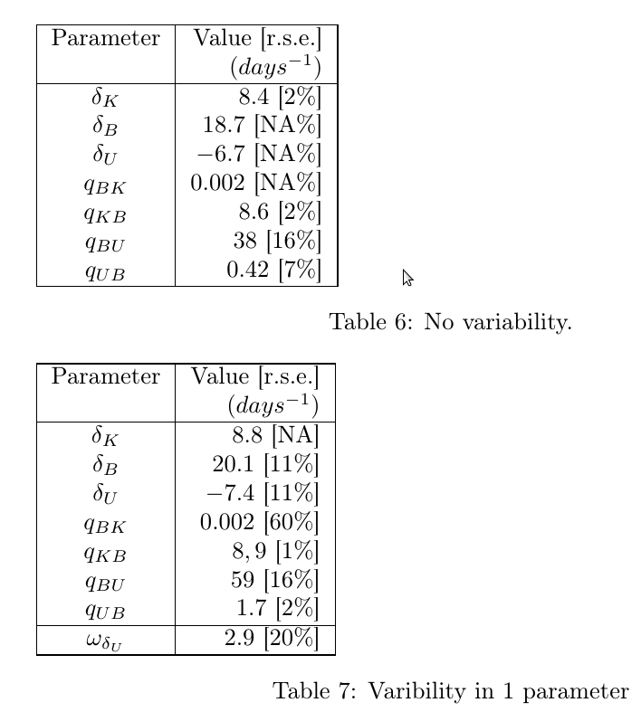
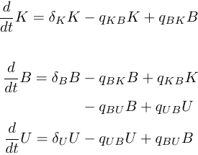
Model Reduction
In
Kidney
Bladder
Urine

Slide 10
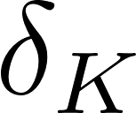
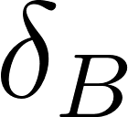







Model Building IIV (1)
In
Kidney
Bladder
Urine
Inter-individual variability systematically tested

Slide 11


Model Building IIV (2)
In
In
Kidney
Bladder
Urine
Kidney
Bladder
Urine
In
Kidney
Bladder
Urine

Slide 12




Simulations
In
Kidney
Bladder
Urine
Monte Carlo simulations to generate 1000 individuals (PAS strain).
Individual is cleared when reach 1 CFU threshold.
Notes:
Show only 95 percent

Slide 13
Is There a Strain Effect?

Slide 14







Strain Covariates
In
Kidney
Bladder
Urine

Slide 15

Clearance
 | PAS | CFT | UTI | NILS69
Kidney | 37 | 43.5 | 55.5 | 34.5
Bladder | 39 | 50.5 | 72.5 | 33.5
Urine | 52 | 68 | 94 | 26

Slide 16
Strain PAS with Ciprofloxacin

Slide 17


Ab Effect
In
Kidney
Bladder
Urine

Slide 18
Conclusions
In
Bladder and Kidney presents large net proliferation rates.
Urine compartment eliminates the infection out of the system and due to its slower clearance make is the primary source of a long lasting bacteria.
NILS69 clears markedly faster than the other strains. UTI strain is the most long standing strain with largest clearance time in all compartments.
Ab effect is difficult to choose a model.
Kidney
Bladder
Urine
Strain

Slide 19
Thanks for your attention

Slide 21





LacZ (PAS)

Slide 22











AB effect
In
Kidney
Bladder
Urine
Absence of AB PK
Assumption AB has an effect on growth(death) rate and not in migration parameters
Which compartments are affected?
Dose effect: proportional?

Slide 23


Slide 24


Slide 26

LacZ circuit
LacZ reveals that there is no replication at the stationary or that it is very small.
So what is the lifetime of a bacteria cell?

Slide 27



In vitro
Can we use this to model
The effect of AB on each kidney and bladder compartment? And assume a linearity on the C_max?

Slide 28


Slide 29
Extras

Slide 30




LacZ+ / LacZ -

Slide 31

Number of Mice
Day
All Bacterias have Control (Ct) and Cipro 10 mg/kg
PAS strain has the most sampling days

